Slide 1
Visualize the value stream
Notes:
Author: Ahmed Hosni
1

Slide 2
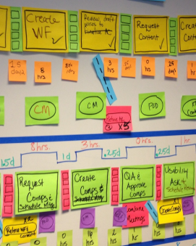
VALUE STREAM MAPS HELP US VISUALIZE
By Applying Systems Thinking and using Lean Thinking Value Stream Mapping tools we:
See how our customer value flows
Create a true picture of the process
ID the relationship of process steps
Create a baseline & Vision of future process
2

Slide 3
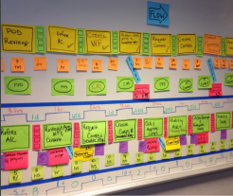
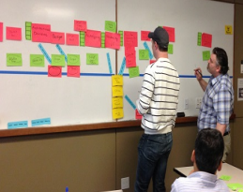
2 TYPES OF VALUE STREAM MAPPING
1. OPTIMIZING PROCESS STEPS | 2. OPTIMIZING BUSINESS CAPABILITIES & PEOPLE
Detailed Process level Mapping Looking for bottlenecks and opportunities for efficiency gain Uses cycle & lead time to continuously improve and reduce transport batches (hand offs) | Enterprise Value Stream Mapping Maps the Flow of Value Through the Enterprise Uses the relationships between ‘how our customers interact’ with us to improve the processes, people, and products that delivery that customer value
3

Slide 4
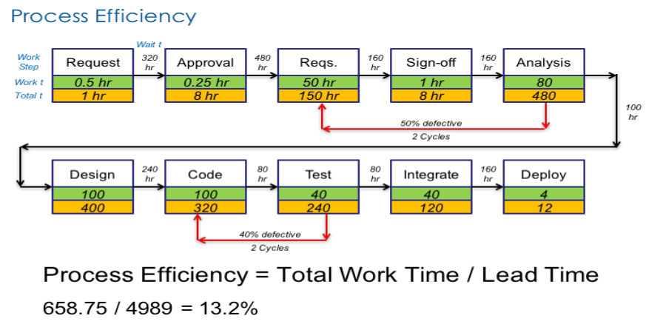
TYPE #1 OPTIMIZATION
4

Slide 5
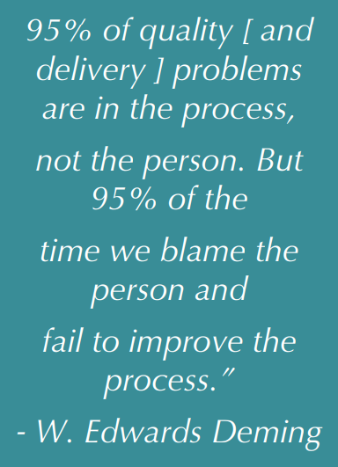
TYPE #1 OPTIMIZATION
STEPS TO IMPROVE:
Wait or idle time between activities
Rework loops – reduce and/or remove
Simplify the existing process
Eliminate steps (if possible) that:
- Don’t add value
- Are not essential
- Don’t change the product or service
Improve efficiency of the bottleneck
5

Slide 6
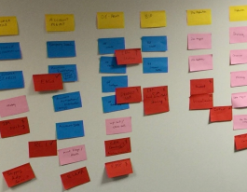
TYPE #2 ENTERPRISE VALUE STREAM
A LEAN PRODUCT DEVELOPMENT AND SYSTEMS THINKING CONSTRUCT
1. Starts with visualizing the ways our customers interact
2. Then decomposes into our Business Capabilities
3. That then decompose into Products/Solutions that delivery those Business Capabilities
4. That then decompose into Systems those Products/Solutions rely on
5. While finally showing the people who work on the systems

Slide 7
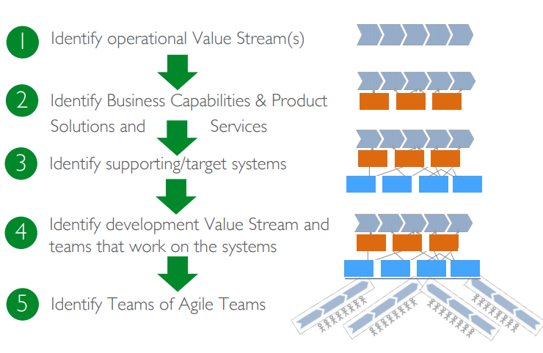
Value Stream Workshop Steps
7

Slide 8
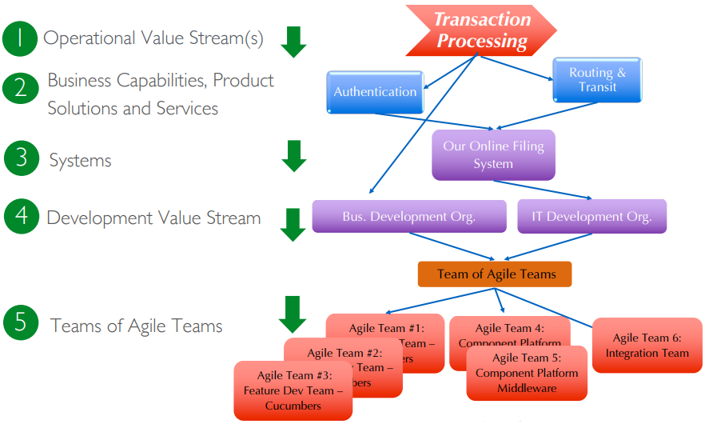
Example
8

Slide 9
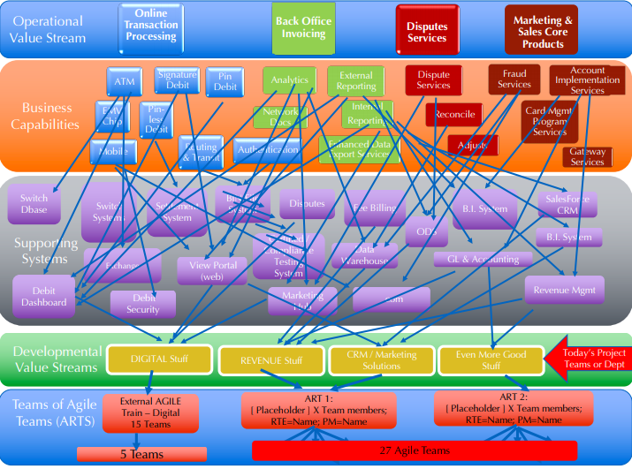
Example of a highly complex enterprise ecosystem
9

Slide 10
USING THE VALUE STREAM MAPPING IN FUTURE STATE PLANNING
Helps with Alignment Between Operations & Development
Provides Transparency and Visualizes Product Enhancements
Helps Improve your organization of Teams of Agile Teams
Improves Flow of Value through smaller batches
10

Slide 11
Questions?

